Slide 1

State of Nevada DIVISION OF INDUSTRIAL RELATIONS WORKERS’ COMPENSATION SECTION
CARDS 101B: Intro to CARDS for Physicians and Chiropractic Physicians
(Claims and Regulatory Data System)

Slide 2

Overview
Objectives
At the completion of this course, training participants will be able to register an account, have a general understanding of how to navigate through the application, and learn how to submit an Online Complaint through the CARDS application.
2

Slide 3

What is CARDS?
CARDS, which stands for “Claims and Regulatory Data System”, is a data collection system for the State of Nevada Workers’ Compensation Section.
For external users in the application, the main function has previously been for indexing claims, running reports, and maintain Insurer and TPA contact information up to date.
With the enhancements to the application, the features will extend to other functionality including, but not limited to; submitting webforms, increased reporting capabilities, processing payments, and improvements to the auditing process.

Slide 4
Registration
User Types
User Permissions and the Role of Account Admin
CARDS Navigation
Complaint Webform
MODULES

Slide 5

CARDS Registration
HOW TO REGISTER A NEW ACCOUNT IN THE CARDS APPLICATION

Slide 6
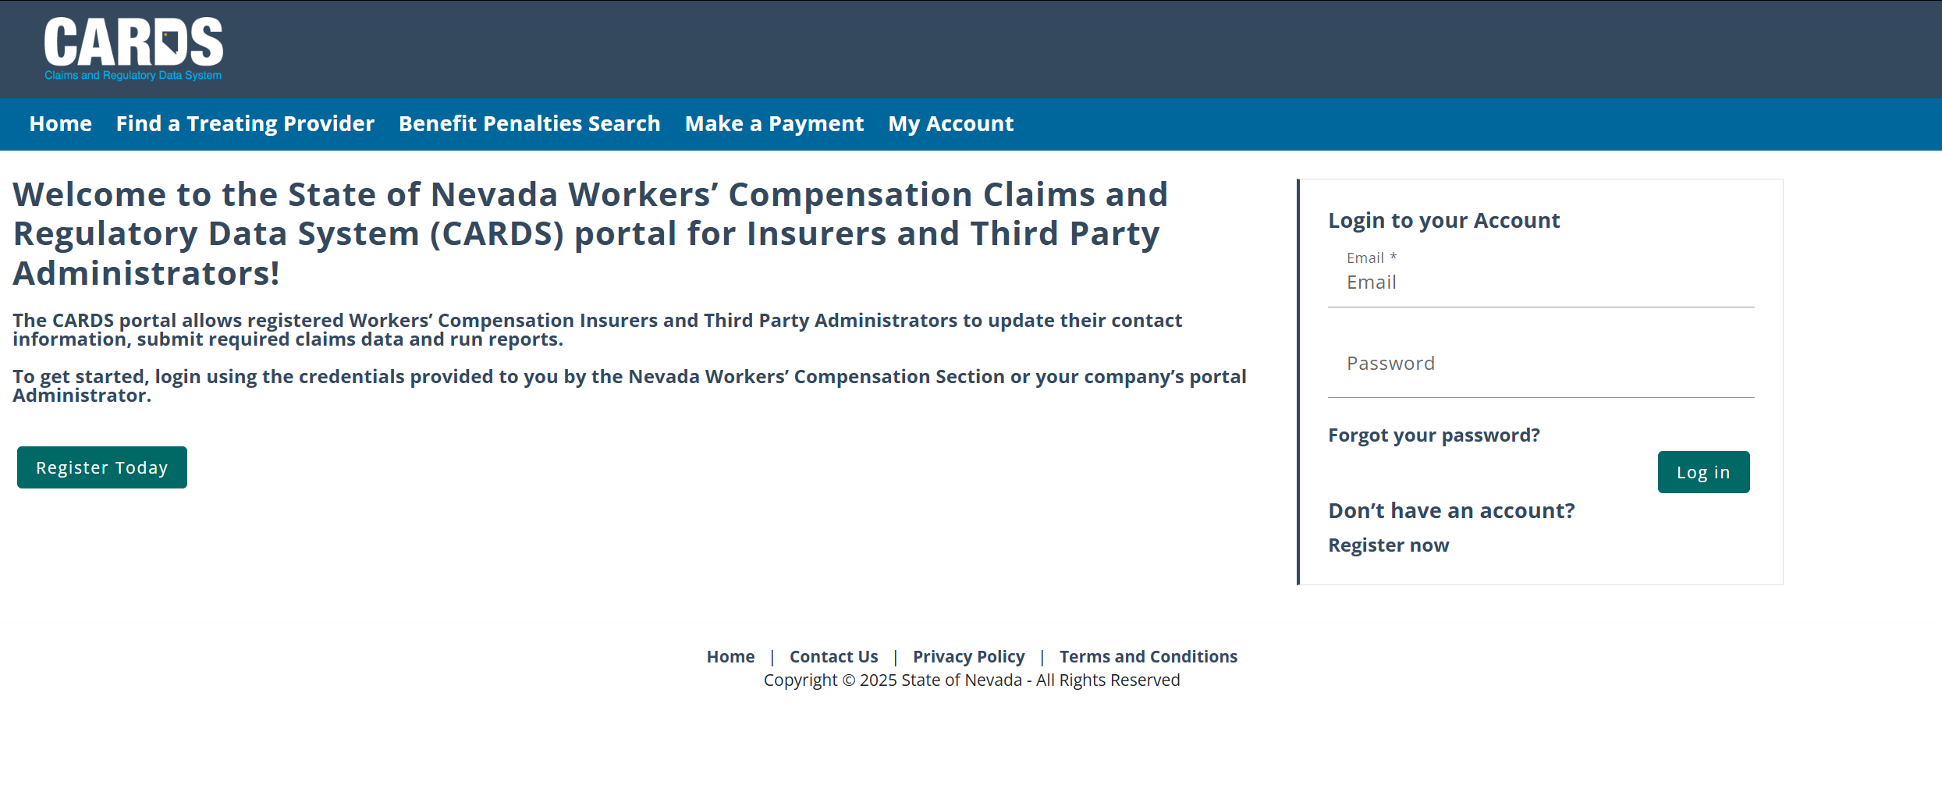
CARDS REGISTRATION
NAVIGATING TO THE CARDS WEBSITE AND COMPLETING ACCOUNT REGISTRATION
Step 1: Navigate to the CARDS site (environment will be available starting June 2nd )
Step 2: Select “Register Today” or “Register now” to initiate the registration process

Slide 7
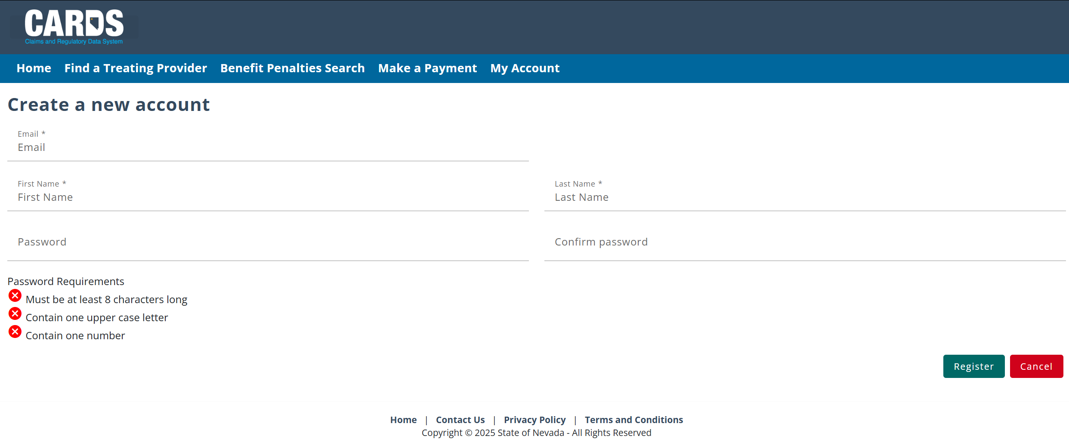
CARDS REGISTRATION
NAVIGATING TO THE CARDS WEBSITE AND COMPLETING ACCOUNT REGISTRATION
Step 3: Enter new log in information
Use the email you have on your Rating Panel application. If it is no longer available, let WCS know.

Slide 8
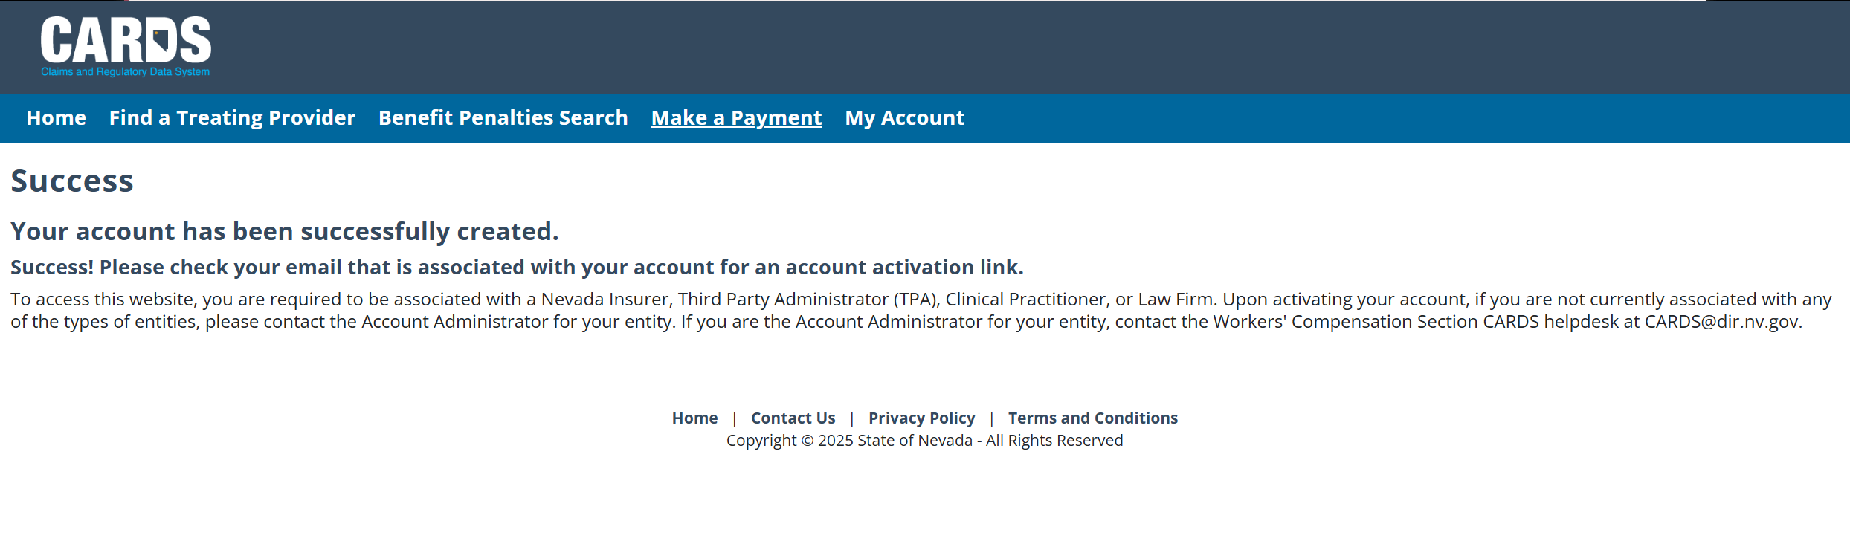
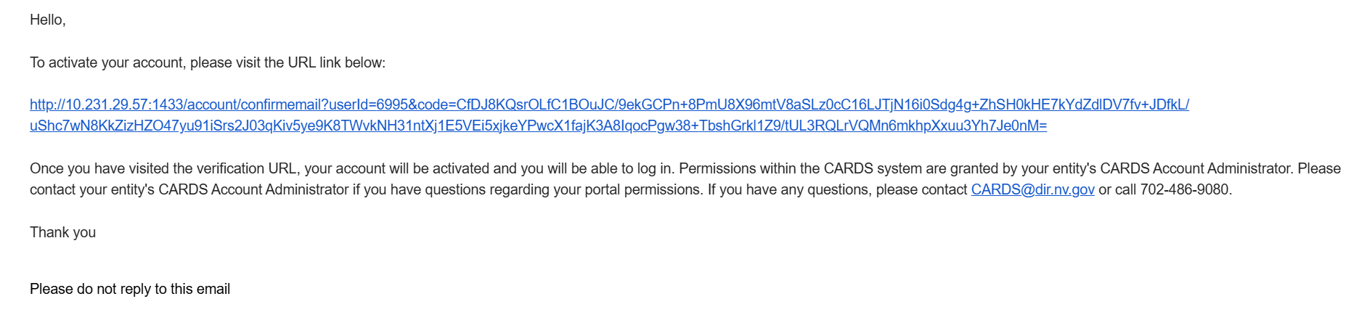
CARDS REGISTRATION
NAVIGATING TO THE CARDS WEBSITE AND COMPLETING ACCOUNT REGISTRATION
Step 4: Activate your account through the email link
Note: Email will be sent by “no-reply@nv.gov”

Slide 9
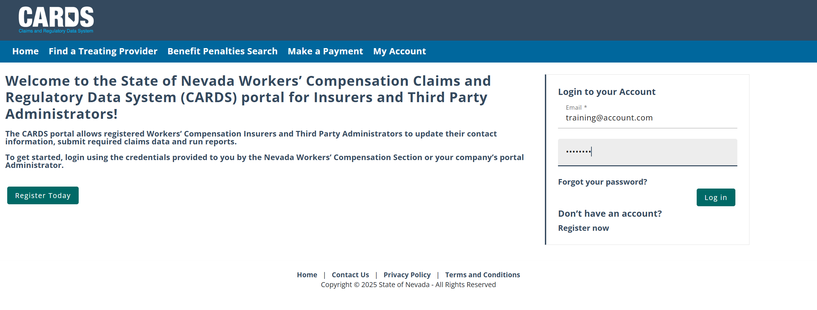
CARDS REGISTRATION
NAVIGATING TO THE CARDS WEBSITE AND COMPLETING ACCOUNT REGISTRATION
Step 5: Log into the CARDS site using the credentials provided at the time of registration

Slide 10
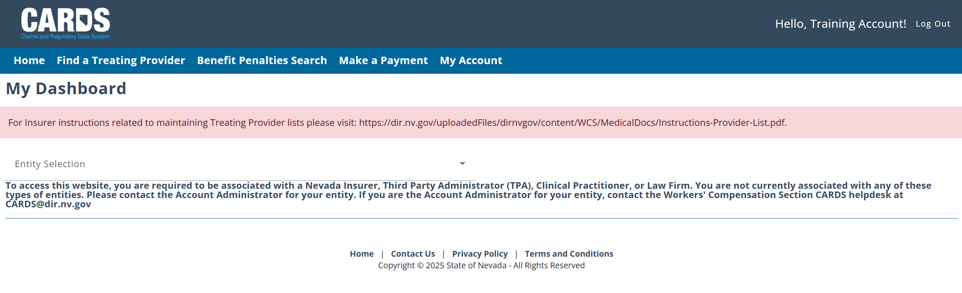
CARDS REGISTRATION
NAVIGATING TO THE CARDS WEBSITE AND COMPLETING ACCOUNT REGISTRATION
Step 6: Ensure your account is associated with an Entity*. If you have not been added to an entity group prior to activating your account, upon login, the homepage appear like the following:
*Entities are the parent account that external user can be linked under. CARDS has the following entity types:
Insurer
Third Party Administrator
Clinical Practitioner
Law Firm
Reach out to the account administrator of the entity you wish to join to be added to the group. The External Users module will review adding users and setting permissions for each user. If you are the administrator of the account and have not been added to the entity group, reach out to WCS (CARDS@dir.nv.gov or call 702-486-9080) to be added to your entity

Slide 11
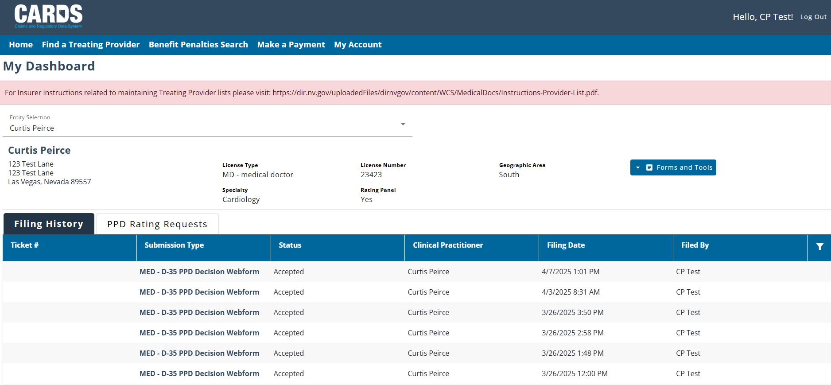
CARDS REGISTRATION
NAVIGATING TO THE CARDS WEBSITE AND COMPLETING ACCOUNT REGISTRATION
Once you are associated with an entity, the homepage will look as follows:
Depending on the type of entity you are related to (Insurer, TPA, Clinical Practitioner, Law Firm), the homepage will vary with what features are displayed. The External Users module will review some of these differences.

Slide 12
CARDS REGISTRATION
NAVIGATING TO THE CARDS WEBSITE AND COMPLETING ACCOUNT REGISTRATION
This function is always visible on the menu bar, but only available to authenticated users.

Slide 13
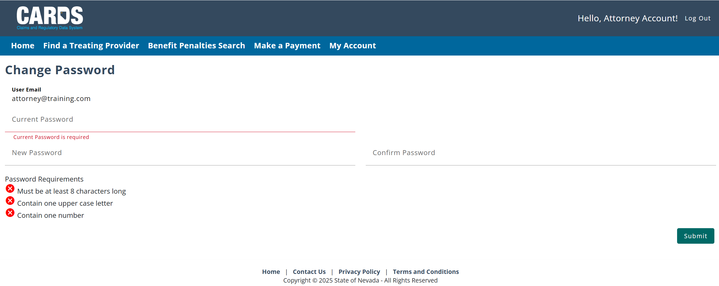
CARDS REGISTRATION
NAVIGATING TO THE CARDS WEBSITE AND COMPLETING ACCOUNT REGISTRATION
Resetting your password

Slide 14
USER TYPES
EXTERNAL USER TYPES IN THE CARDS APPLICATION

Slide 15
USER TYPES
EXTERNAL USER TYPES IN THE CARDS APPLICATION
Insurers: Already included as users in the CARDS application. Insurer users will be associated with at lease one Insurer entity and have may have a relationship to TPAs.
Third Party Administrators (TPAs): Already included as users in the CARDS application. TPA users will be associated to their TPA entity and can be granted permissions to perform actions on behalf of an Insurer.
Attorneys: New user type in the CARDS system. Attorneys are associated with a Law Firm entity, submitting forms on behalf of injured workers.
Clinical Practitioners: New user type in the CARDS system. Their entity will be the Clinical Practitioner Profile, they will be set up as admins and can have a few additional authenticated users on their account. Clinical practitioners will primarily use CARDS to submit evaluation forms for injured workers.

Slide 16
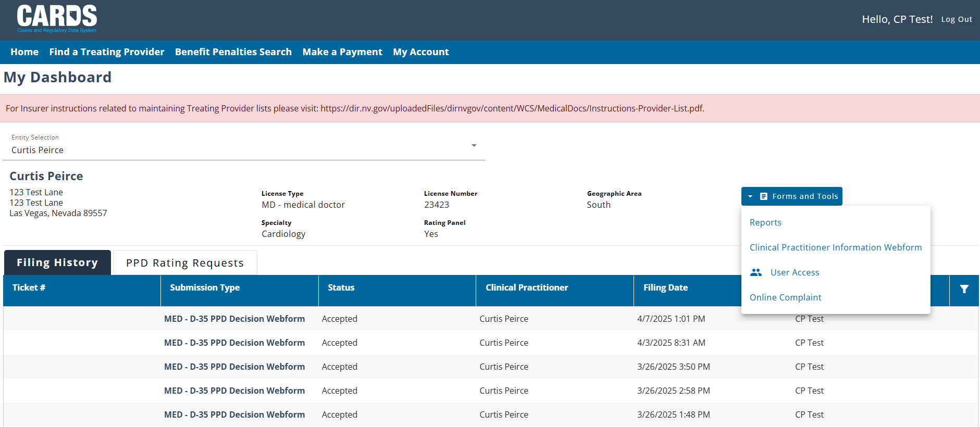
CLINICAL PRACTITIONER HOMEPAGE
EXTERNAL USER TYPES IN THE CARDS APPLICATION

Slide 17
KNOWLEDGE CHECK

Slide 18
User Permissions and the Role of an Account Admin
ACCESSING CARDS FUNCTIONS BY ROLE

Slide 19
USER PERMISSIONS
ACCOUNT ADMINS FOR ENTITY GROUPS
Each Entity group will have a designated admin user who will be responsible for setting permissions for each user that is added to the group. Admins can only be set up by the internal WCS staff, which will be done when the Entity is added to the CARDS application.

Slide 20
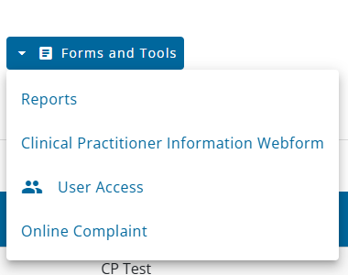
USER PERMISSIONS
ACCOUNT ADMINS FOR ENTITY GROUPS
Setting user permissions allows account admin to control what CARDS functions individual accounts can access based on their role. Permissions can be set or updated from the User Access accessible through the Forms and Tools menu on the homepage.

Slide 21
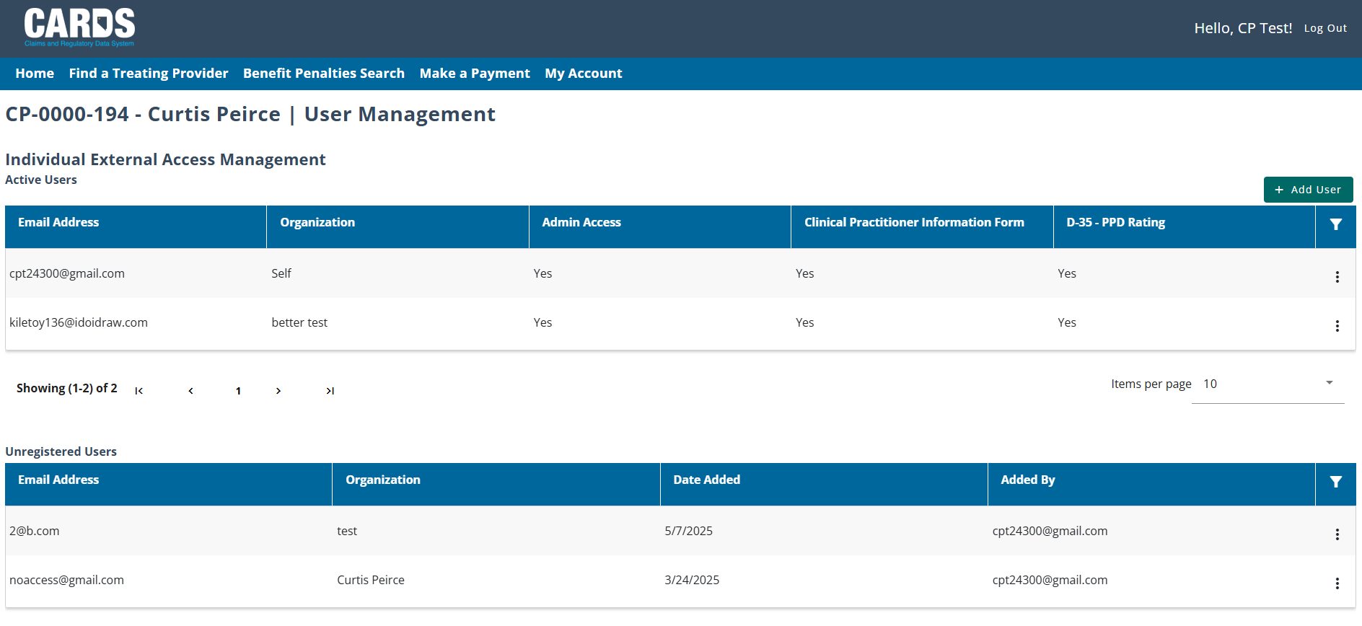
USER PERMISSIONS
ACCOUNT ADMINS FOR ENTITY GROUPS

Slide 22
CARDS NAVIGATION
GENERAL NAVIGATION IN THE CARDS APPLICATION

Slide 23
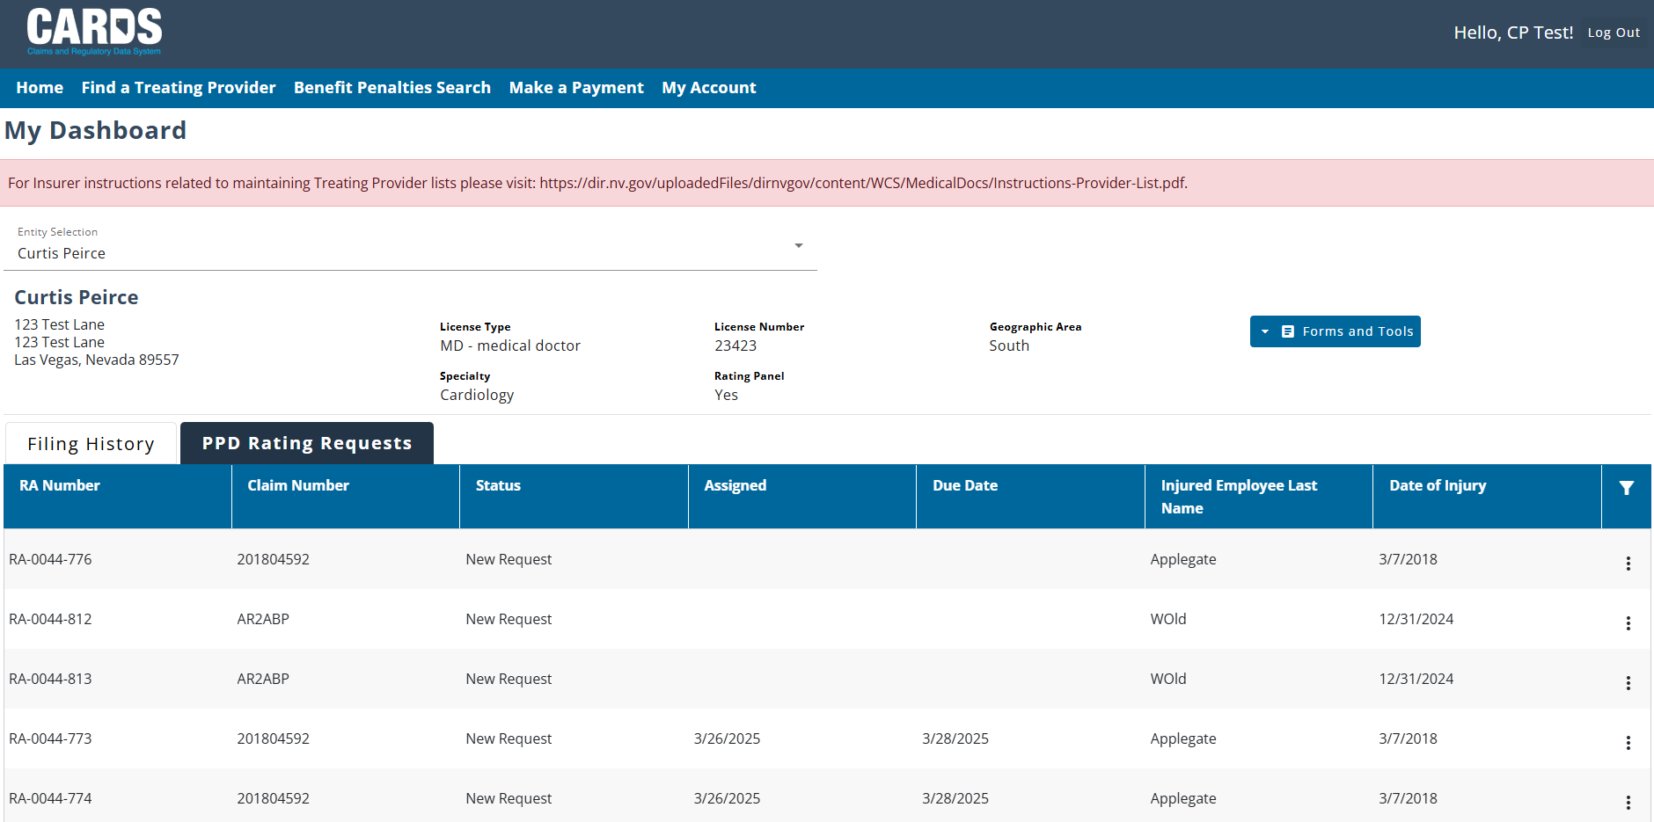
CARDS NAVIGATION
GENERAL NAVIGATION IN THE CARDS APPLICATION

Slide 24
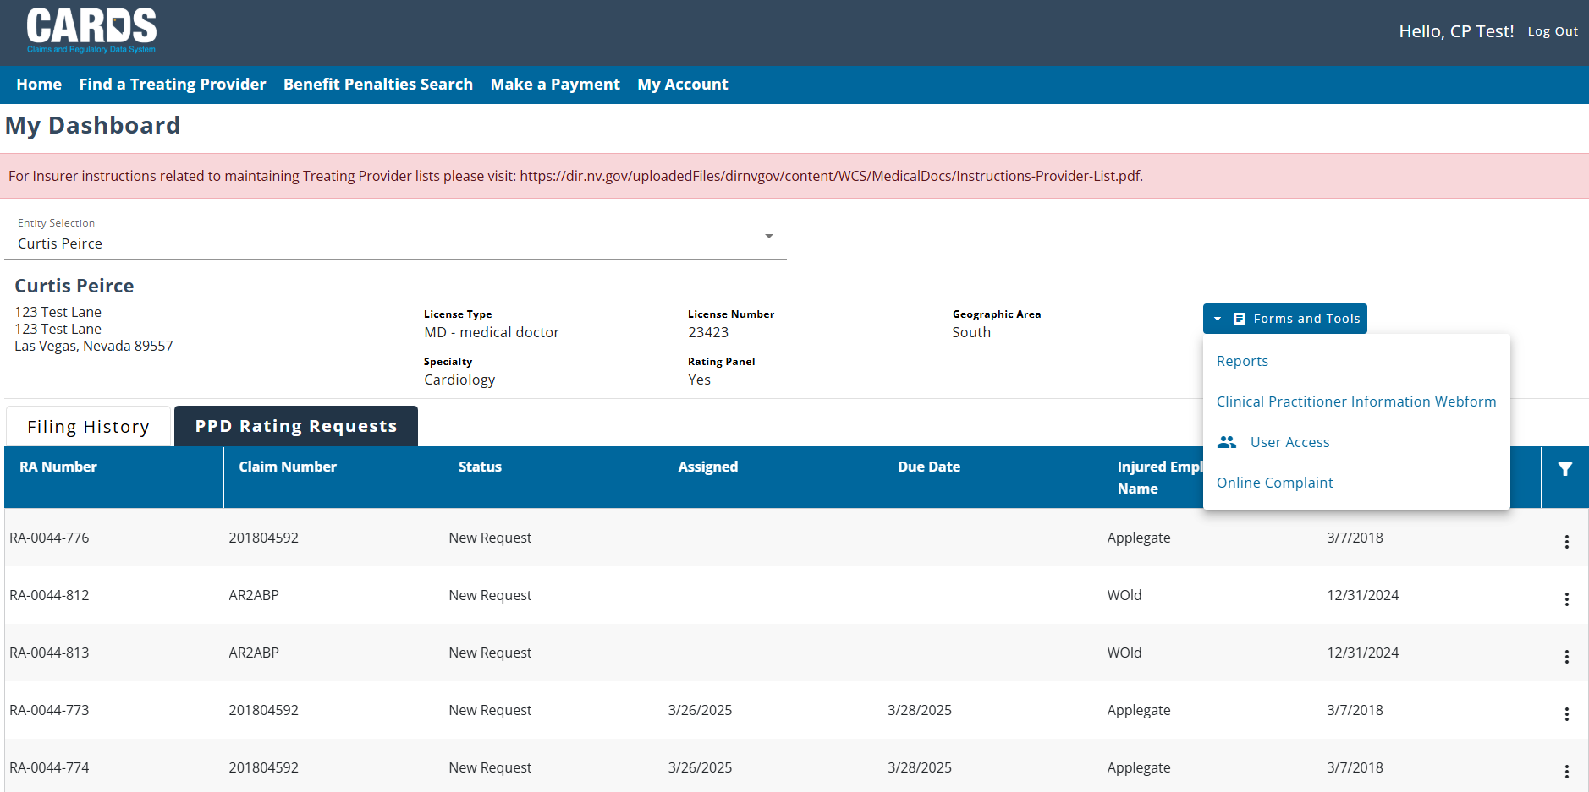
CARDS NAVIGATION
GENERAL NAVIGATION IN THE CARDS APPLICATION

Slide 25
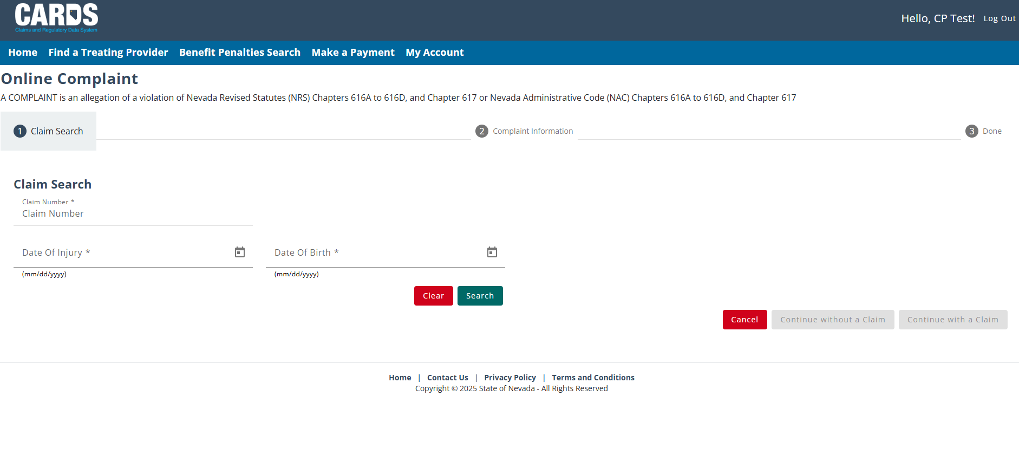
CARDS NAVIGATION
GENERAL NAVIGATION IN THE CARDS APPLICATION
Note: Put information on these prompts if you know the required data. If not, put bogus information so that the “Continue without a Claim” will be an option. Hit Search then click on “Continue without a Claim”.

Slide 26
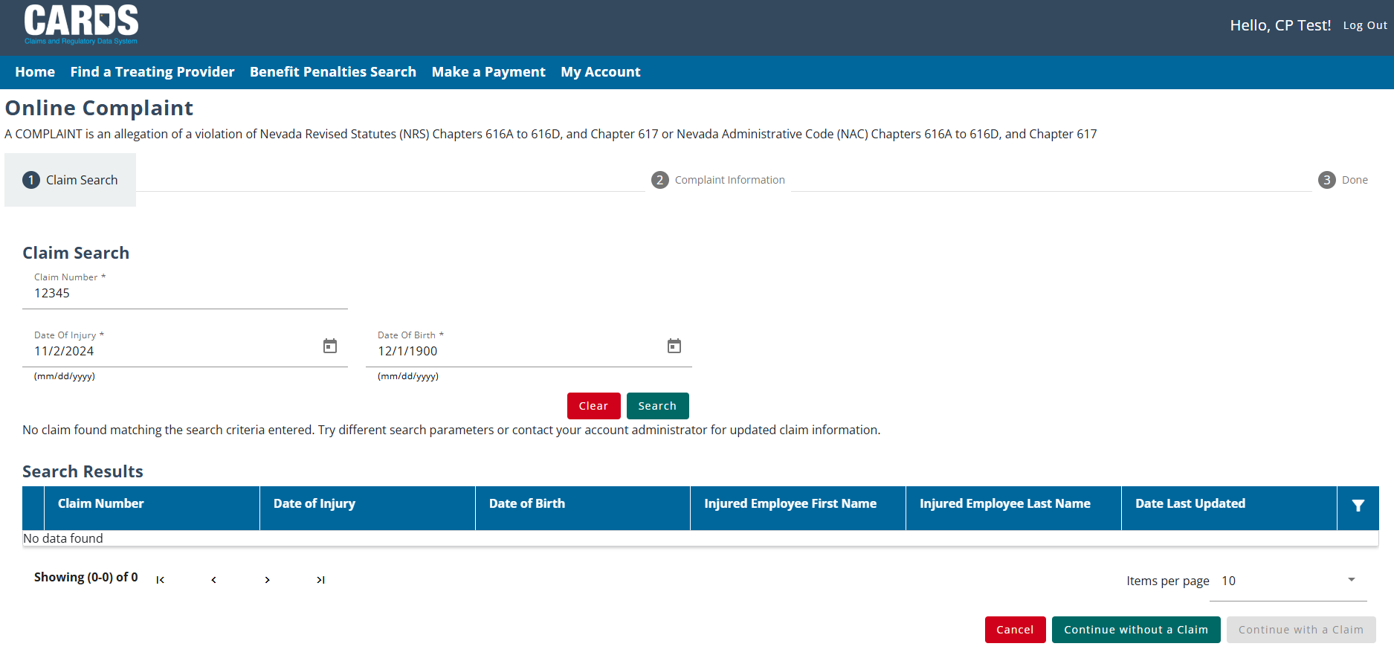
CARDS NAVIGATION
GENERAL NAVIGATION IN THE CARDS APPLICATION

Slide 27
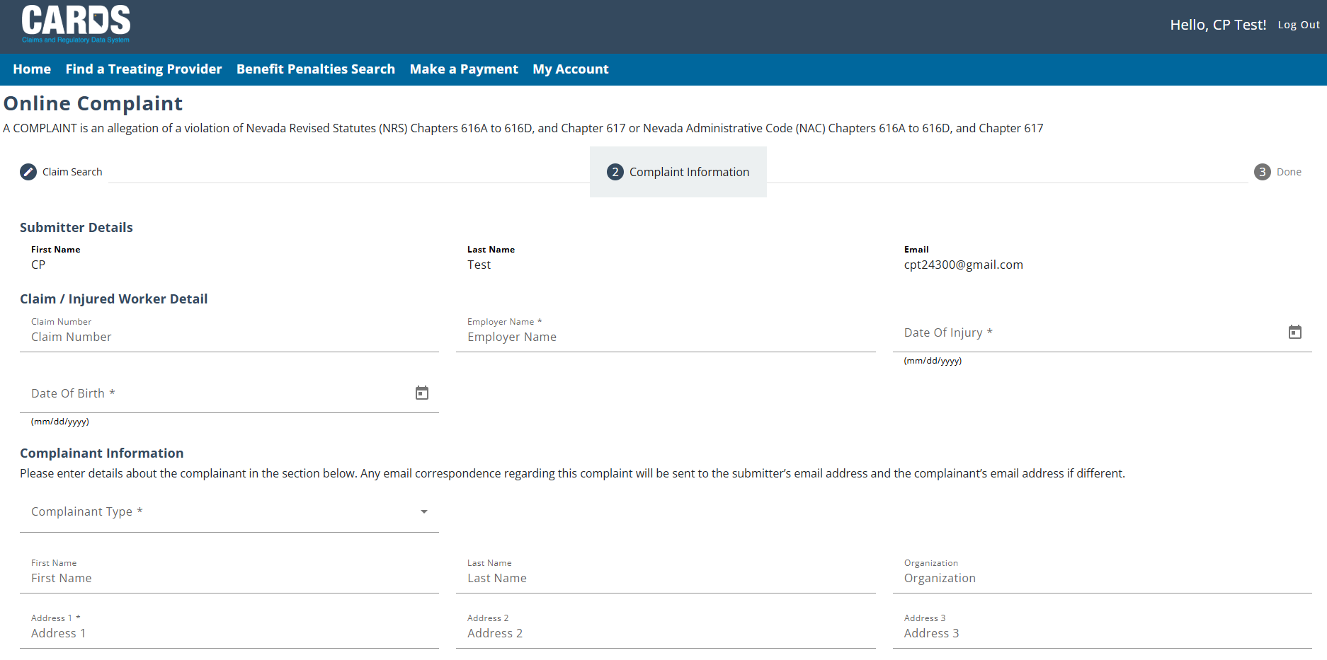
CARDS NAVIGATION
GENERAL NAVIGATION IN THE CARDS APPLICATION

Slide 28
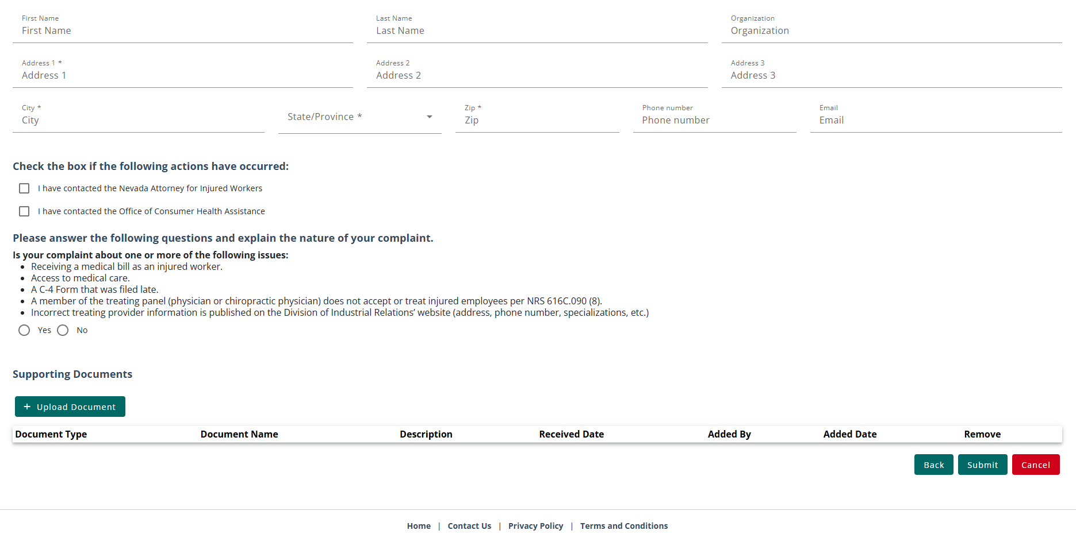
CARDS NAVIGATION
GENERAL NAVIGATION IN THE CARDS APPLICATION

Slide 29
COMPLAINT WEBFORM
FILING A COMPLAINT FOR NON-AUTHENTICATED USERS

Slide 30
COMPLAINT WEBFORM
FILING A COMPLAINT IN CARDS FOR NON-AUTHENTICATED USERS
One of the new features of CARDS is the ability to file an online complaint. The form will gather basic information about the complainant and the details of the complaint, as well as asking a series of questions to determine the nature of the compliant. Once the complaint form is submitted, it will be routed to the proper department to be worked depending on what the complaint relates to.
There are two complaint forms available within CARDS. For users with CARDS accounts, the complaint form is accessible using their Forms and Tools menu. For others who do not have an account, there is a publicly available complaint form located in the navigation ribbon on the log in page.
Users will be provided with a Complaint confirmation number that can be used for any future communications with the investigator assigned to the complaint.

Slide 31
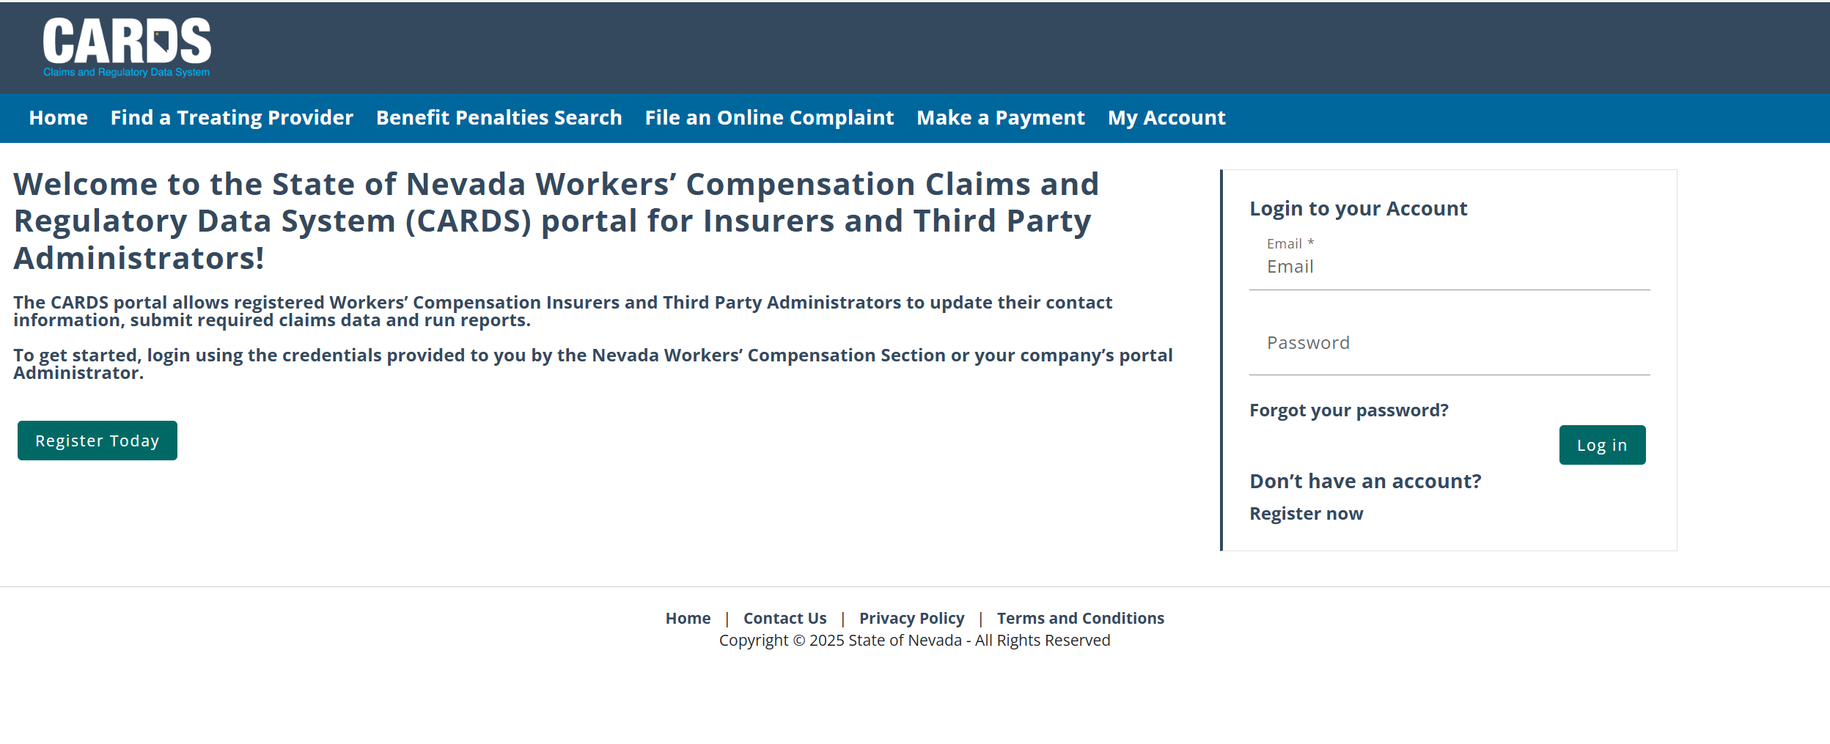
COMPLAINT WEBFORM
FILING A COMPLAINT IN CARDS FOR NON-AUTHENTICATED USERS

Slide 32
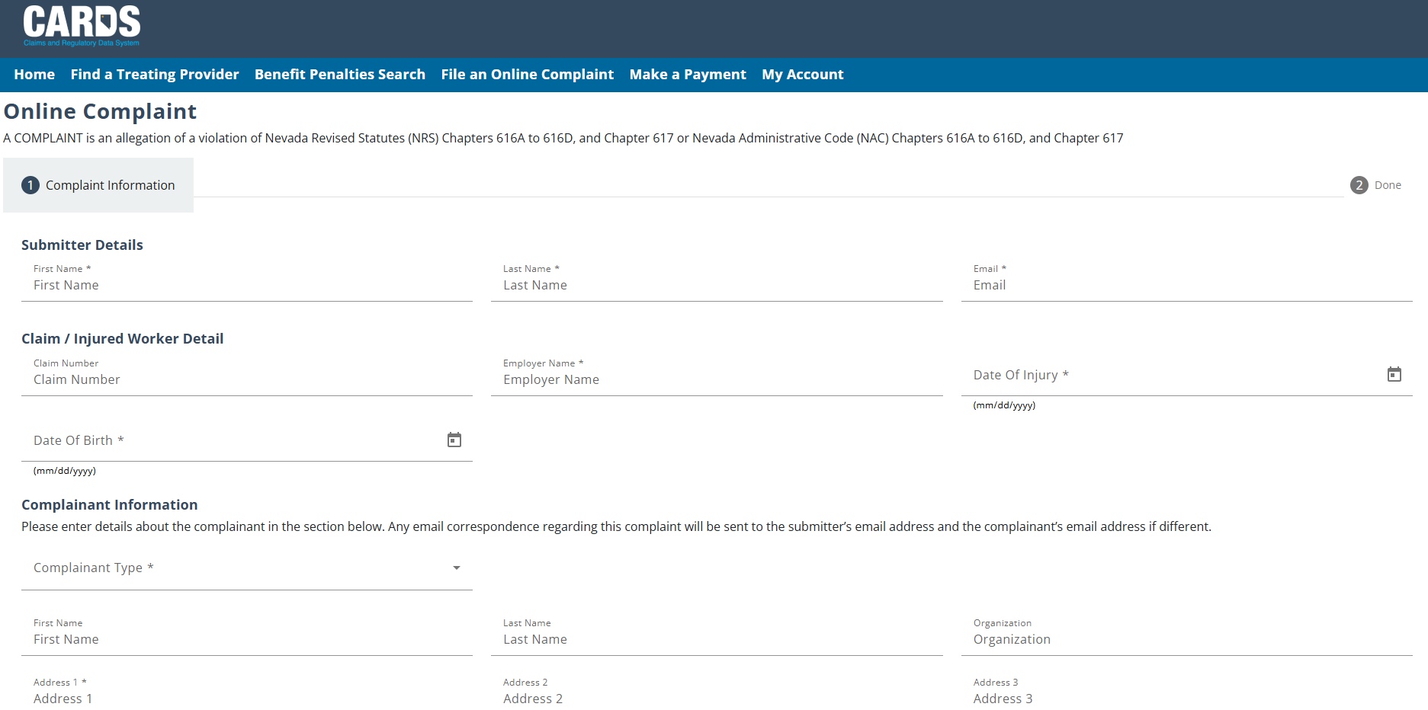
COMPLAINT WEBFORM
FILING A COMPLAINT IN CARDS FOR NON-AUTHENTICATED USERS

Slide 33
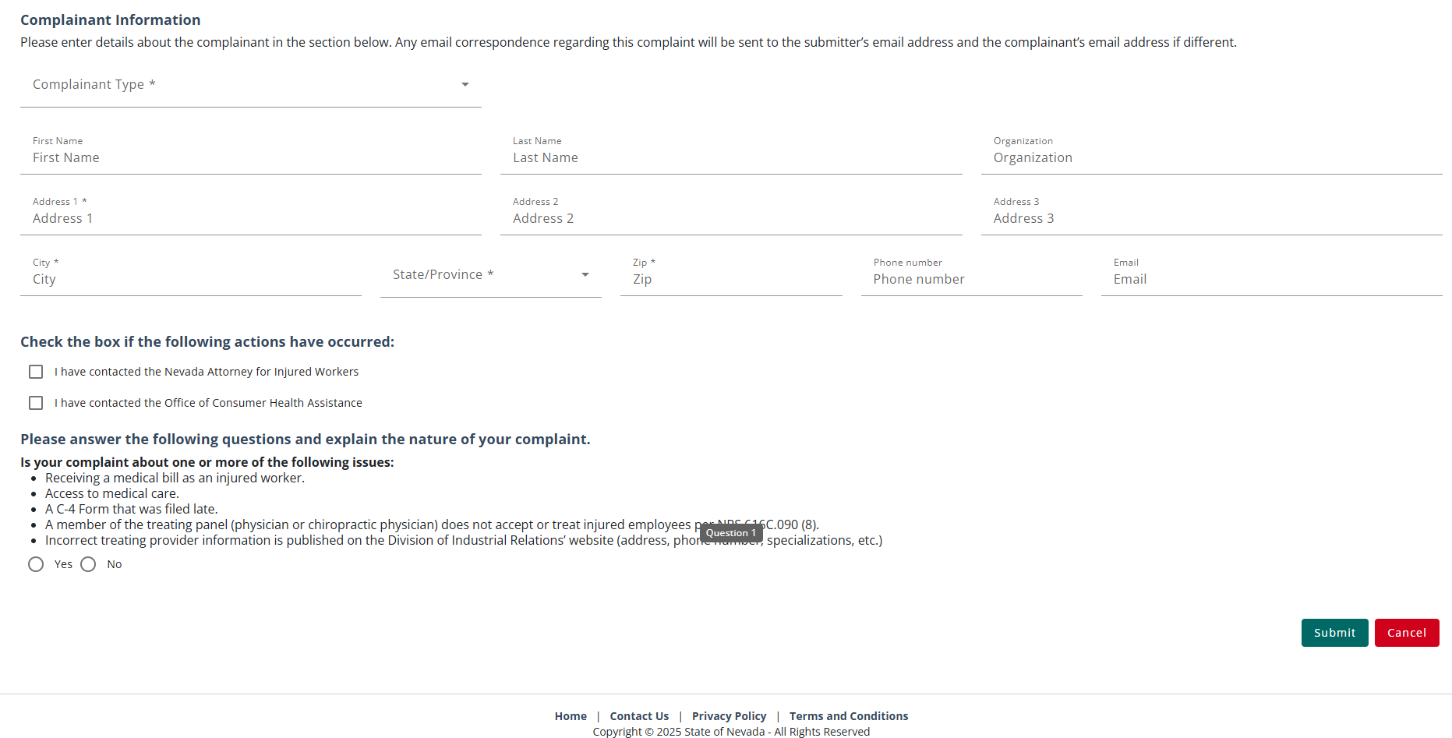
COMPLAINT WEBFORM
FILING A COMPLAINT IN CARDS FOR NON-AUTHENTICATED USERS

Slide 34
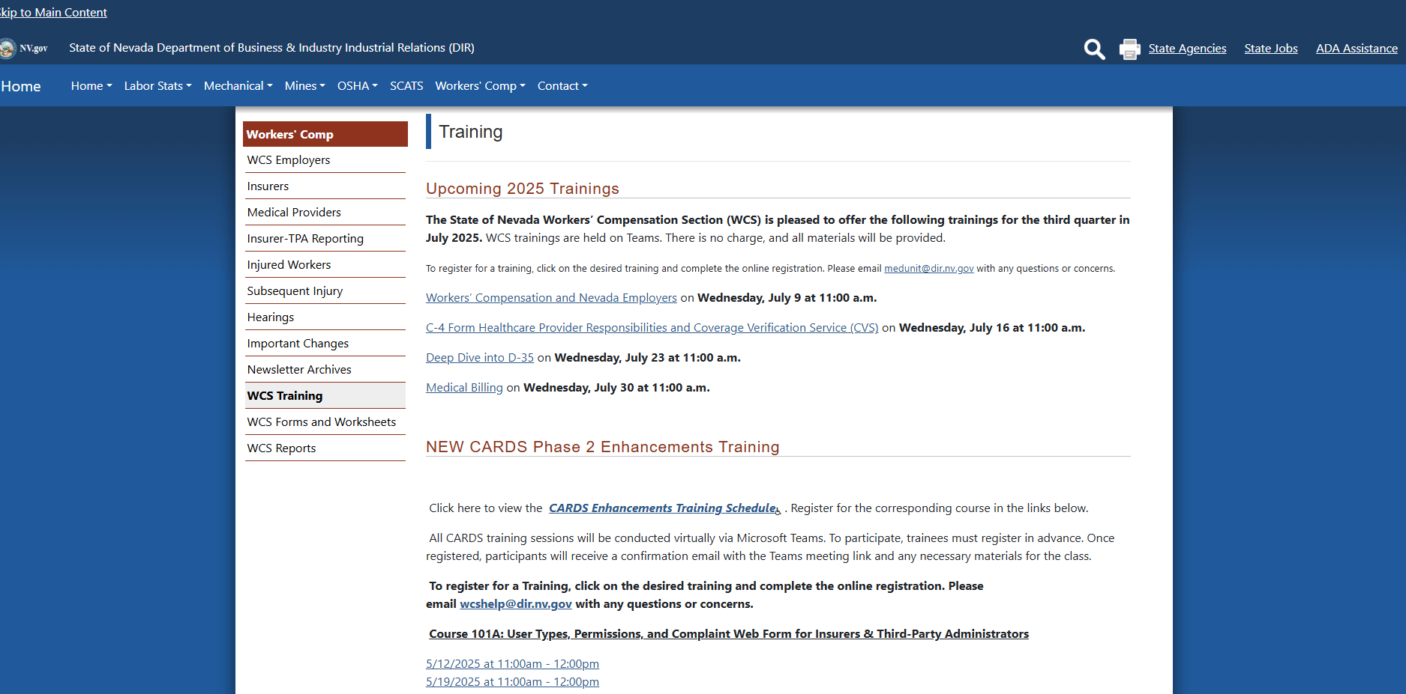
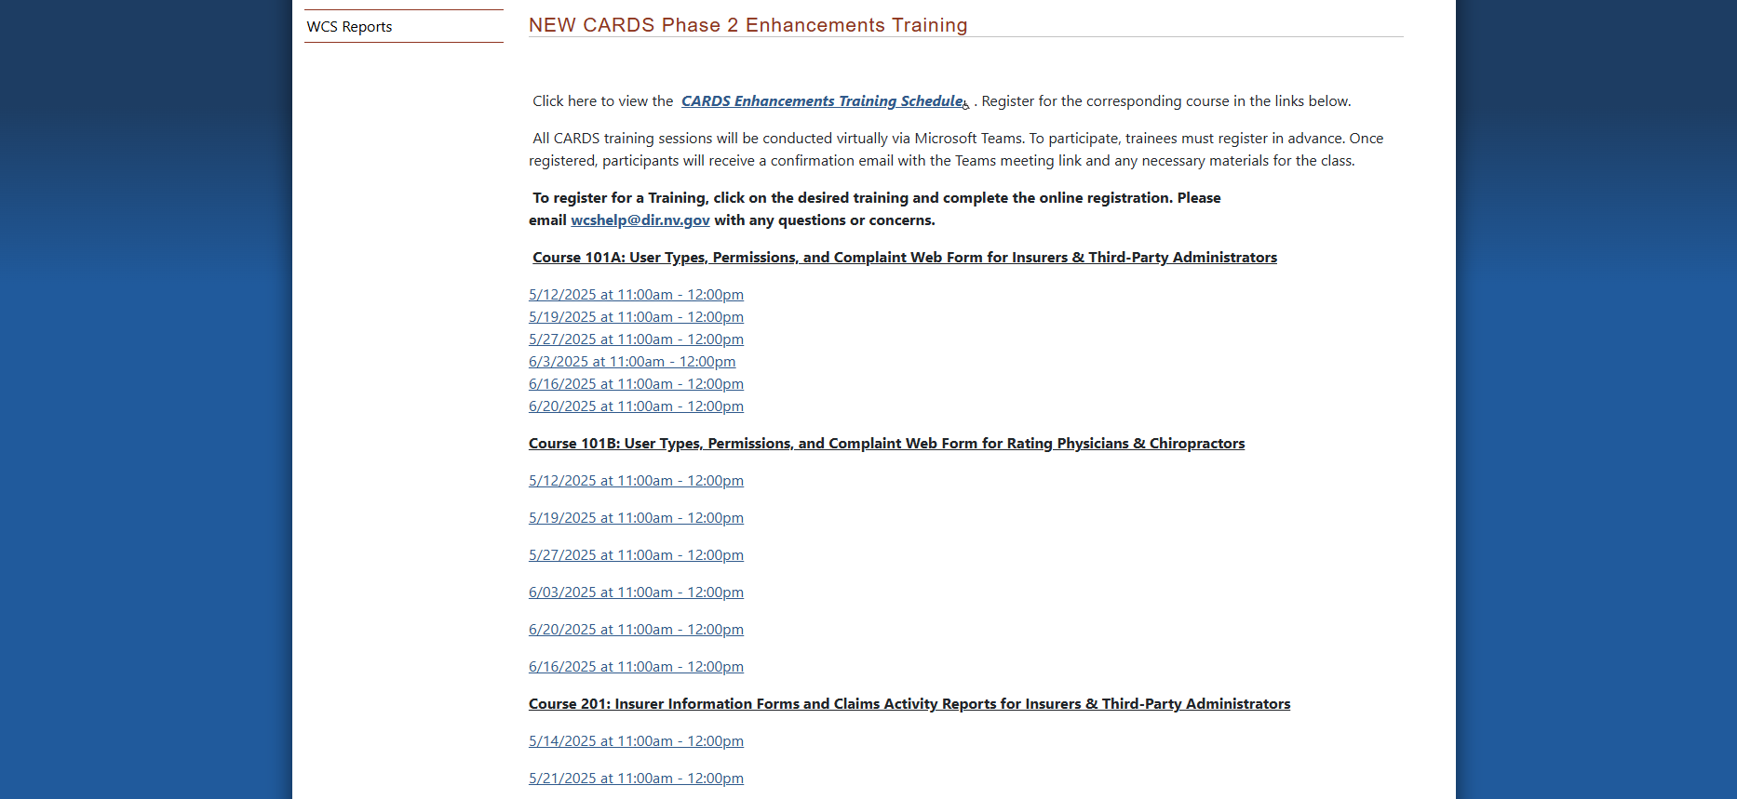
WHAT’S NEXT?

Slide 35

QUESTIONS?

Slide 36


THANK YOU

