Slide 1

State of Nevada
DIVISION OF INDUSTRIAL RELATIONS
WORKERS’ COMPENSATION SECTION
CARDS 301A: Electronic D-35 for Physicians and Chiropractic Physicians
(Claims and Regulatory Data System)

Slide 2

Overview
Objectives
At the completion of this course, training participants will be able to respond to a rating request for a permanent partial disability and submit their rating report on a request.

Slide 3
INSURER/TPA OR INJURED WORKER/REP SUBMITS A REQUEST FOR RATER USING THE D-35 WEBFORM TO WCS
WCS PROCESS THE D-35 AND ASSIGNS THE PPD RATING TO A RATER
RATER ACCEPTS OR DECLINES THE ASSIGNMENT
IF ACCEPTED, RATER PERFORMS PPD EVALUATION
The claim needs to be “Indexed” first in our CARDS system before a Request for a Rater is processed by WCS.

Slide 4
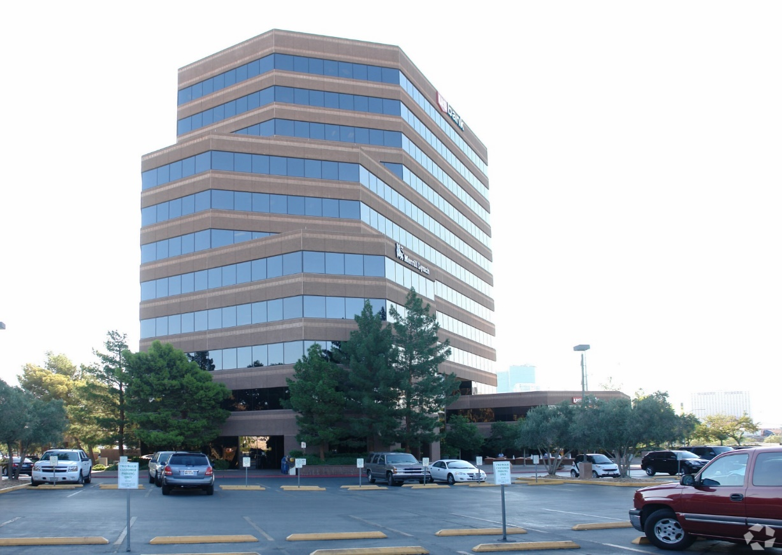
D-35 WEBFORM TO
REQUEST A RATER
RATING PROCESS FOR CLINICAL PRACTITIONERS

Slide 5
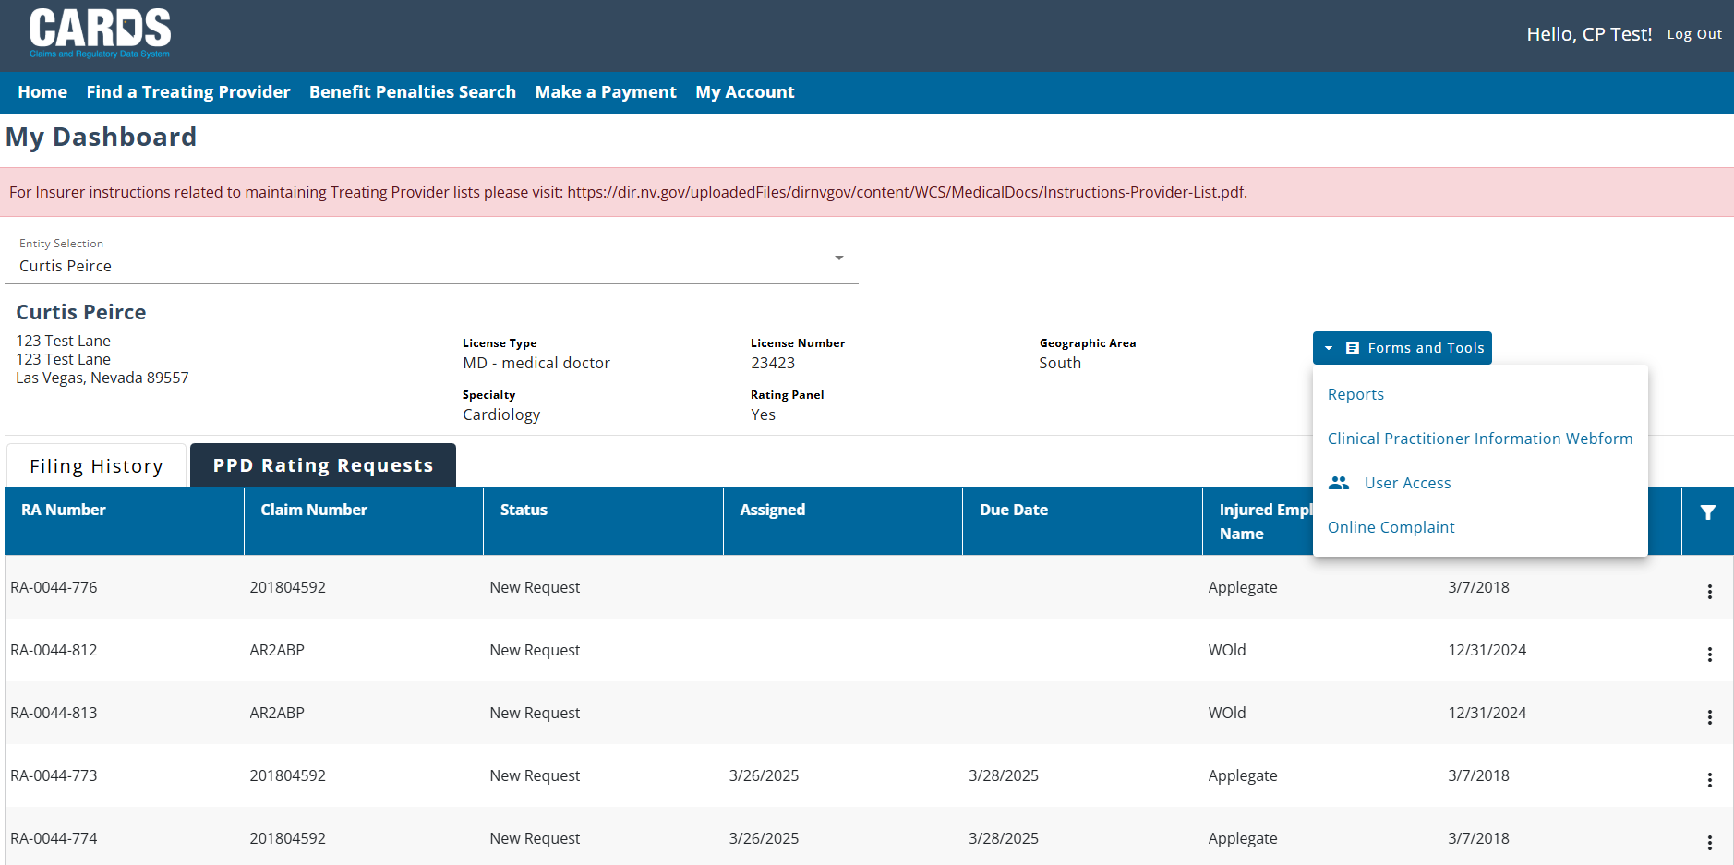
CLINICAL PRACTITIONER HOMEPAGE
EXTERNAL USER TYPES IN THE CARDS APPLICATION
The look of your dashboard will depend on the kind of access you were given.

Slide 6
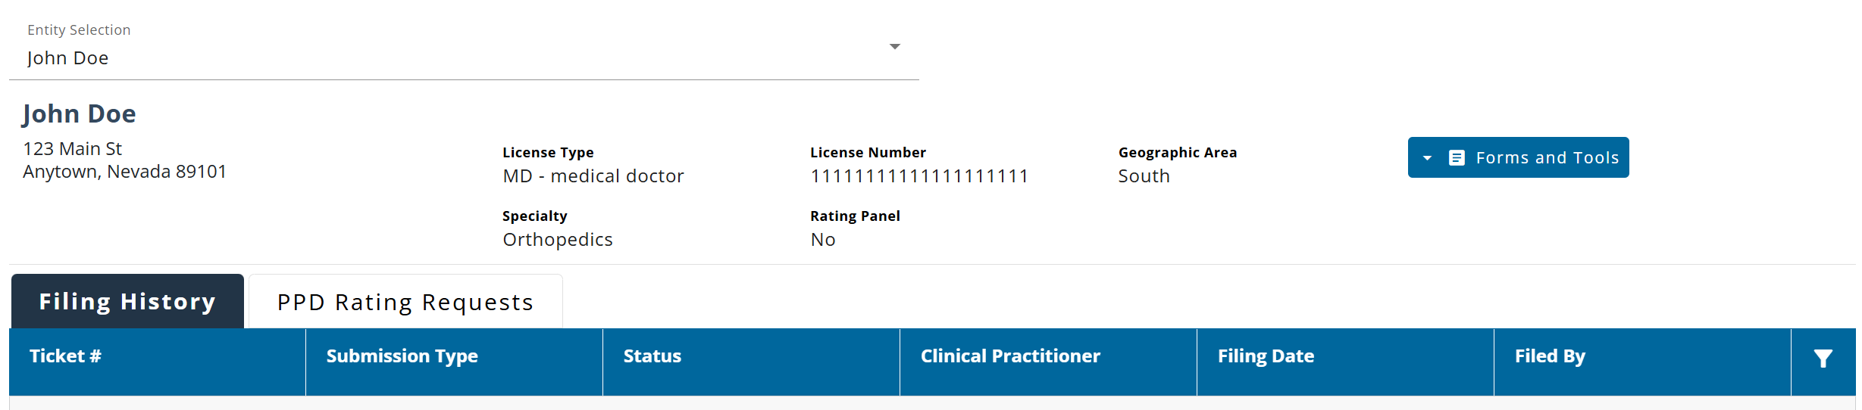
D-35 USER PERMISSIONS
ACCESSING THE WEBFORM
Once permissions have been applied, the user should be able to see the “PPD Rating Requests” tab on the external homepage. This will be where all requests can be acted on.

Slide 7
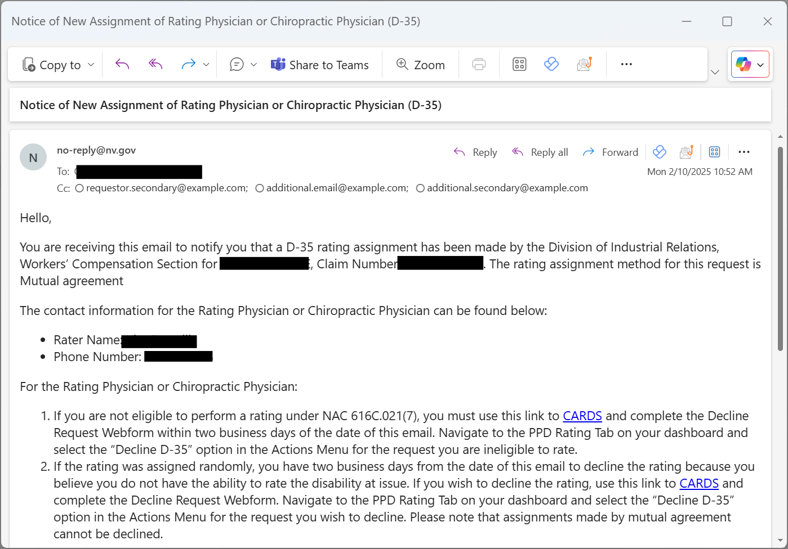
VIEWING THE D-35 AS A CLINICAL PRACTITIONER
ACCESSING THE WEBFORM
As a clinical practitioner, you will be able to view a read-only version of the D-35 for rating requests that have been assigned to you. Once you have been assigned a PPD request, you will receive an email notification that you have a new request.

Slide 8
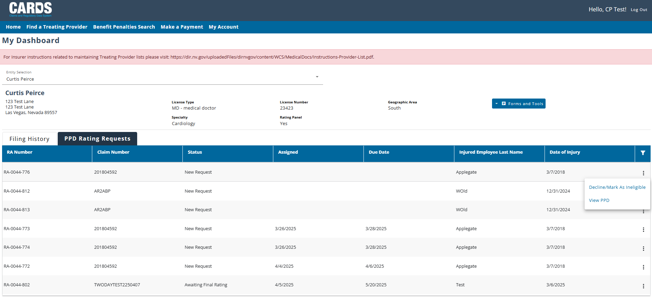
VIEWING THE D-35 AS A CLINICAL PRACTITIONER
ACCESSING THE WEBFORM
Watchout for New Requests

Slide 9
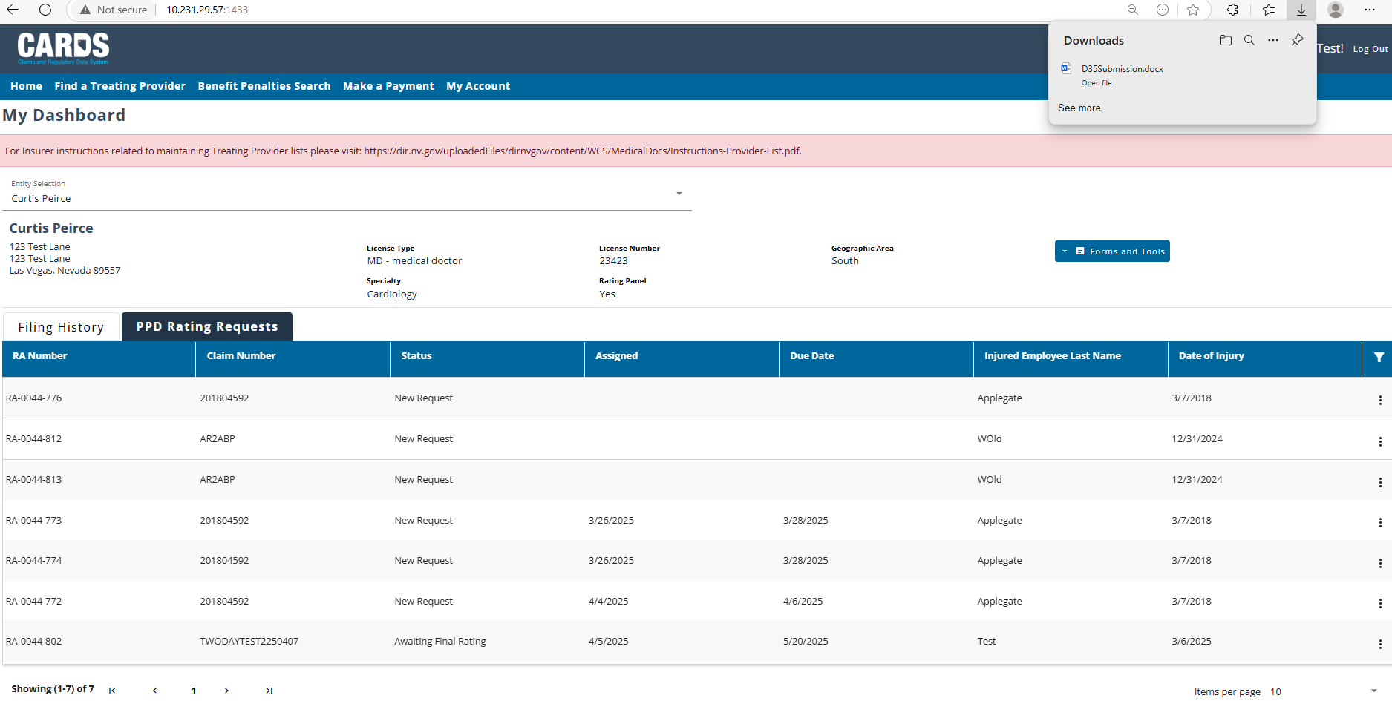
VIEWING THE D-35 AS A CLINICAL PRACTITIONER
ACCESSING THE WEBFORM
Click on View PPD and a Word Document version of the D-35 will be generated. Review the D-35.

Slide 10
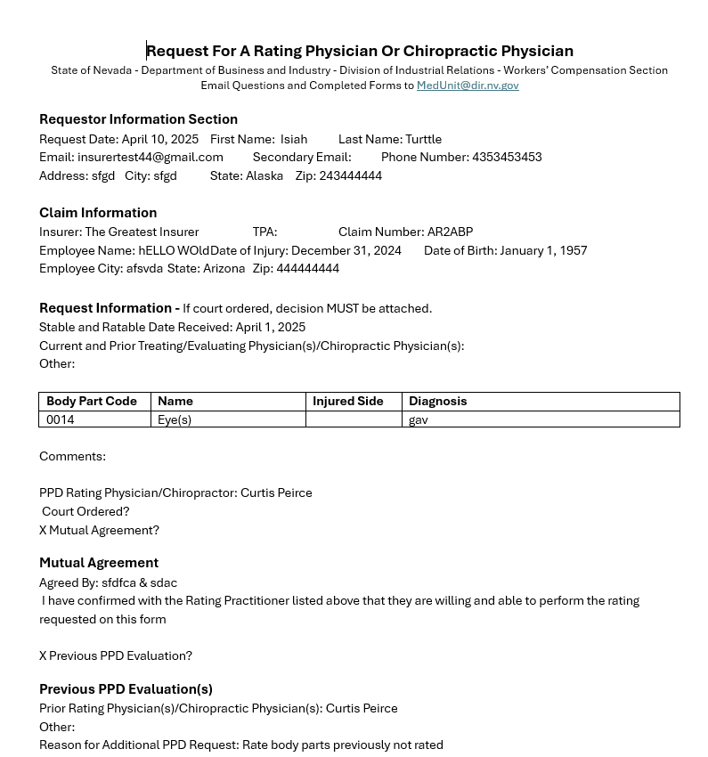
D-35 WORD DOC
ACCESSING THE WEBFORM

Slide 11
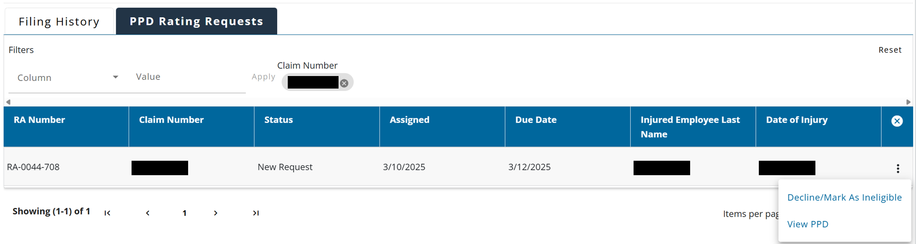
NAVIGATION
RESPONDING TO A PPD RATING REQUEST
Once you have been notified that you have been requested as a rating physician or practitioner, you can view the request in the PPD Rating Table under the PPD Rating Process Tab. The PPD transaction will have a New Request Status. If you believe that you are unable to complete the rating or are ineligible to complete the rating, you can select the Decline/Mark As Ineligible action. This action will bring you to the Request Decision Webform.

Slide 12
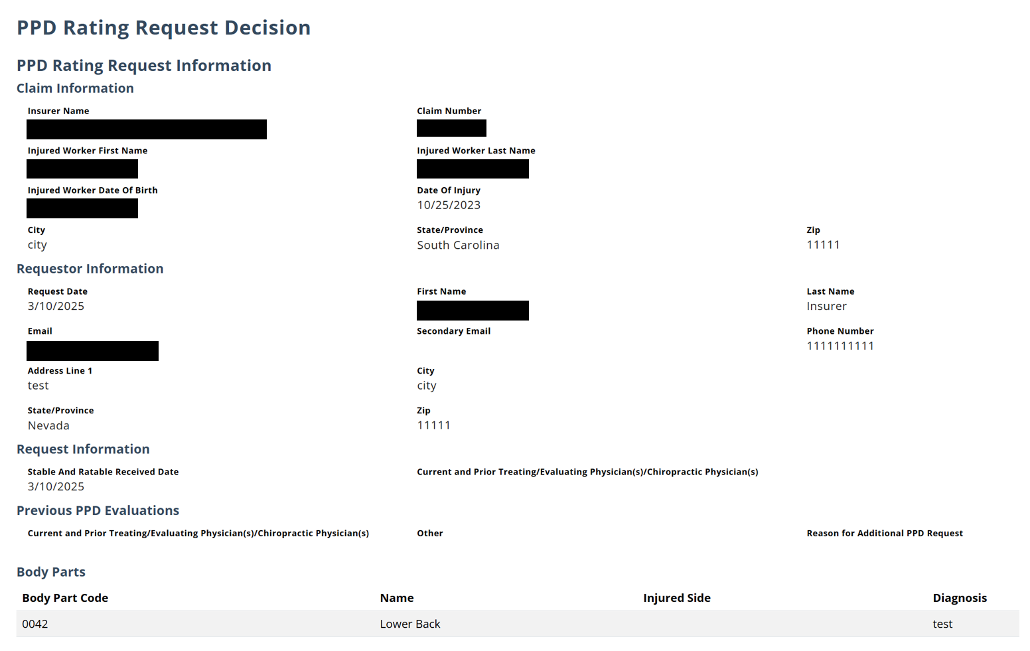
REQUEST DECISION WEBFORM
RESPONDING TO A PPD RATING REQUEST
The Request Decision Webform will allow you to see information about the D-35 and submit a statement of decline or a statement of ineligibility. The form displays the submitted data from the D-35 webform to help inform your decision.

Slide 13
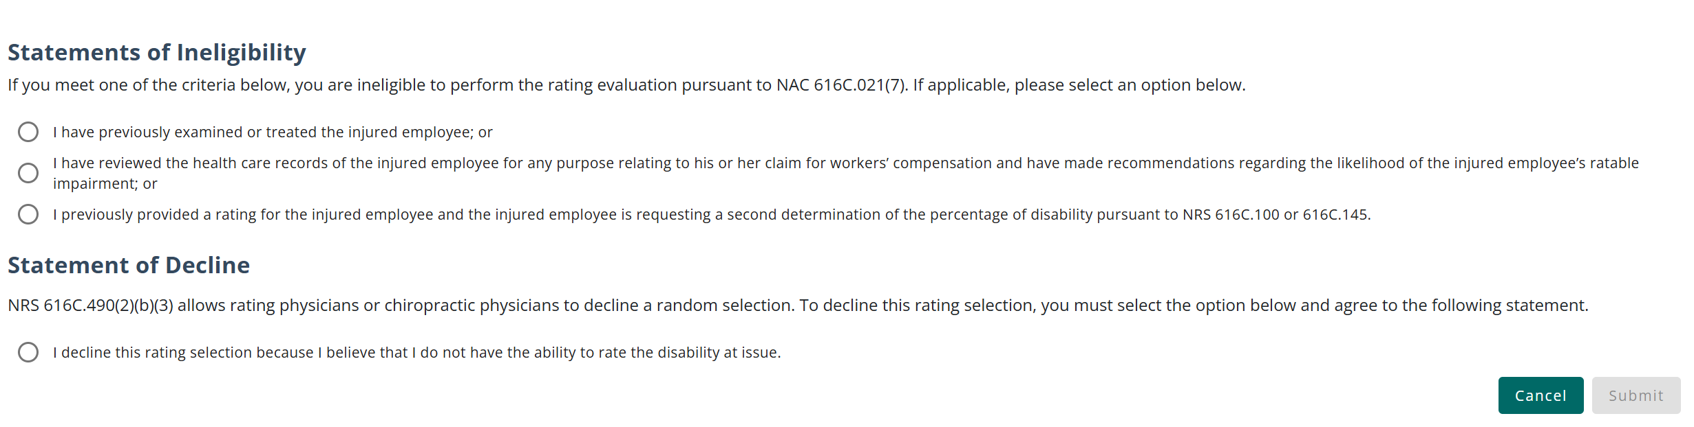
REQUEST DECISION WEBFORM
RESPONDING TO A PPD RATING REQUEST
You are required to select either one of the statements of ineligibility or the statement of decline before submitting the webform. Select the response that most accurately describes the reason you will not be performing the rating.

Slide 14
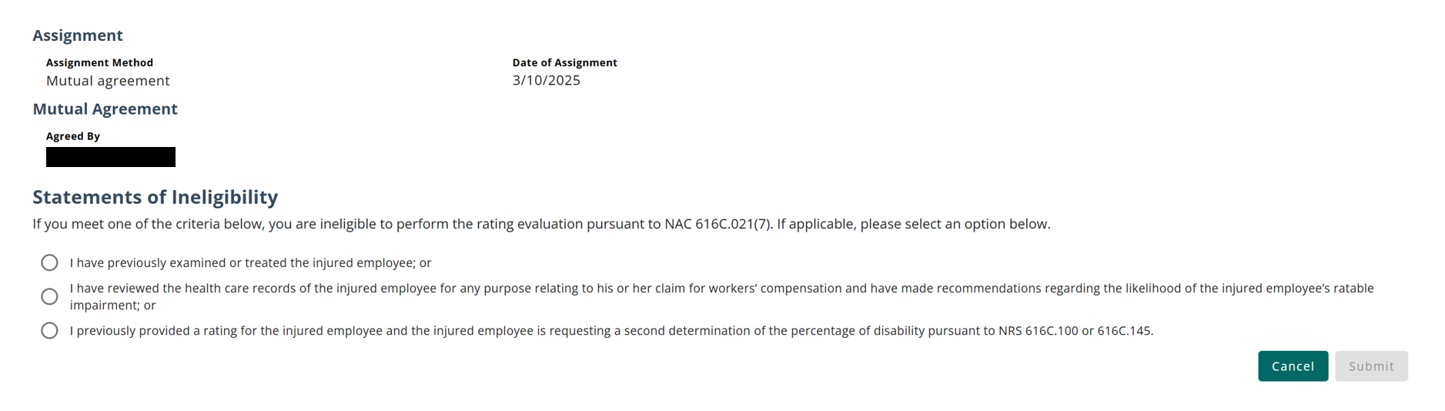
REQUEST DECISION WEBFORM
RESPONDING TO A PPD RATING REQUEST
For PPD requests that are a Mutual Agreement, you will only be able to select an ineligibility reason on the Request Decision Webform.

Slide 15
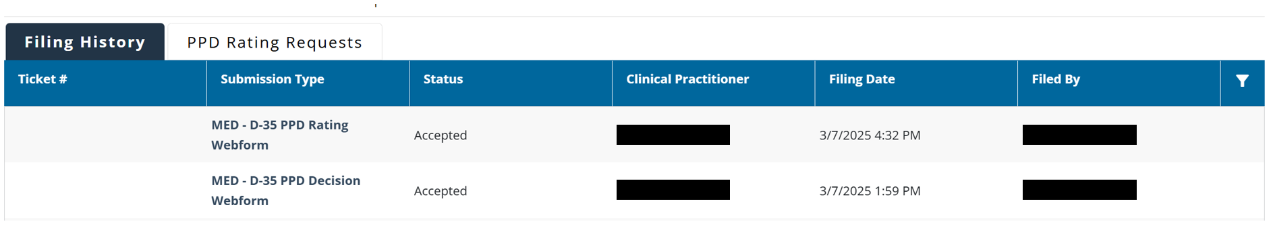
WEBFORM SUBMISSIONS IN FILING HISTORY
RESPONDING TO A PPD RATING REQUEST
As webforms are submitted, they will be available to view in the Filing History tab on the dashboard. By selecting the submission, you will be able to see a view-only version of the webform.

Slide 16
KNOWLEDGE CHECK

Slide 17
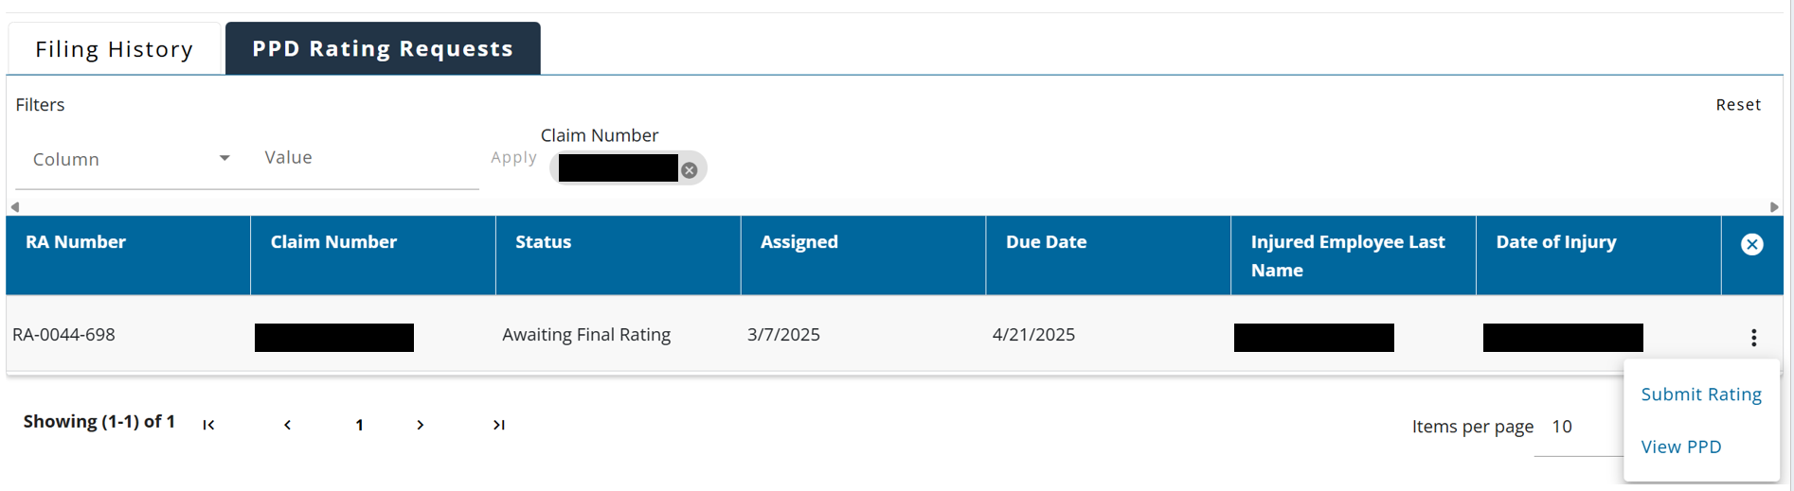
COMPLETING THE RATING
RESPONDING TO A PPD RATING REQUEST
If you believe you are eligible to perform the rating and will not be declining the request, after two days from the date of assignment, the request will move into the “Awaiting Final Rating” status, giving you the ability to perform the rating on the request. Appointments with the injured worker will be coordinating outside of CARDS between the interested parties.

Slide 18
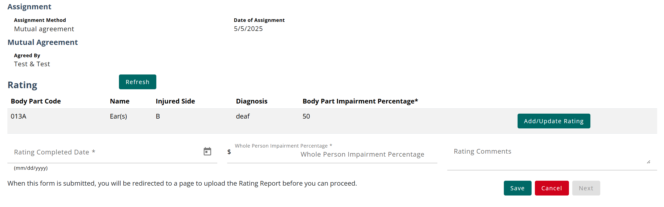
PPD RATING WEBFORM
RESPONDING TO A PPD RATING REQUEST
Once the rating has been conducted, the Clinical practitioner can navigate to the Rating Webform. On this webform, you will be able to submit the necessary information for the PPD rating based on your evaluation of the injured worker.

Slide 19
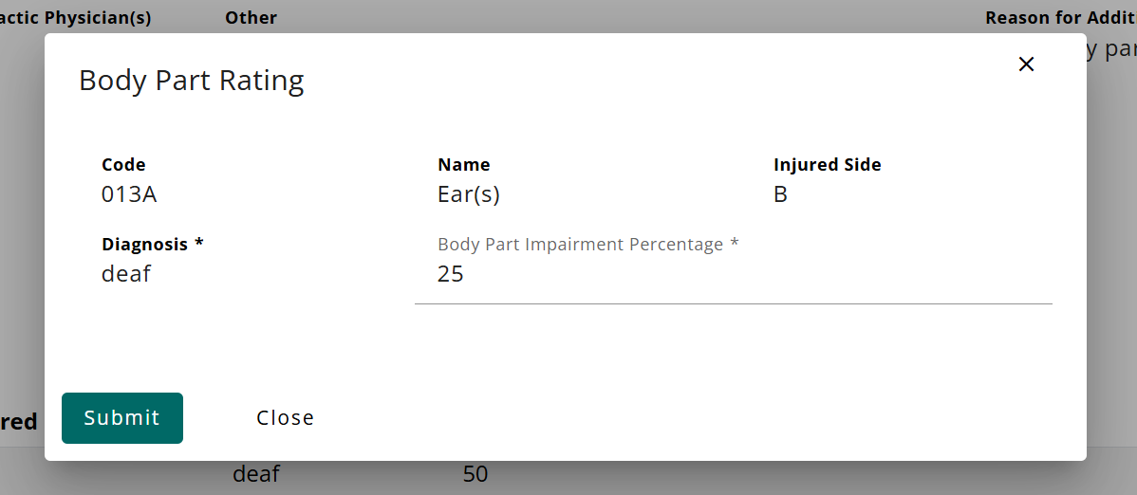
PPD RATING WEBFORM
RESPONDING TO A PPD RATING REQUEST
You will provide a Body Part Rating for each body part listed by recording the impairment percentage.

Slide 20
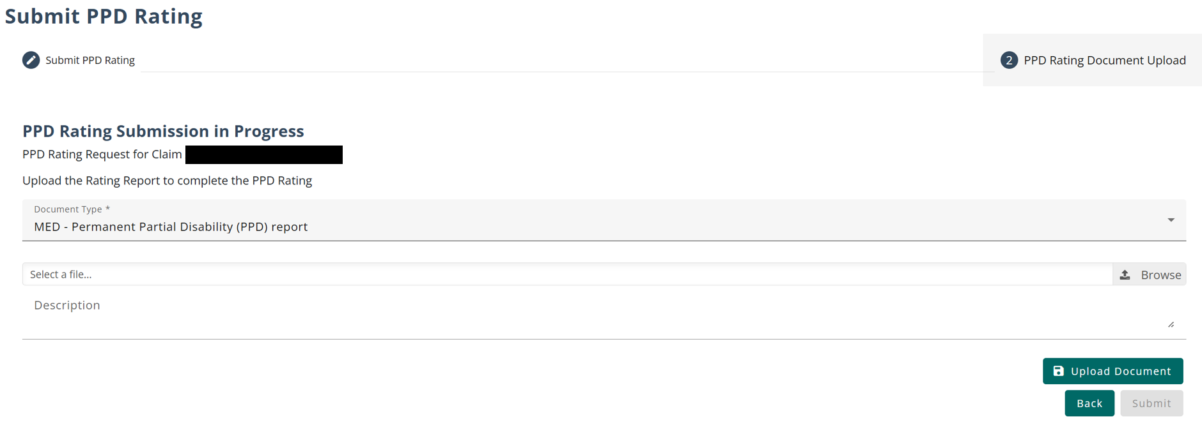
PPD RATING WEBFORM
RESPONDING TO A PPD RATING REQUEST
The final step before submitting the PPD Rating Webform is uploading the PPD Report document. Once the webform is submitted, the status of the request will update to “Rating Complete”

Slide 21
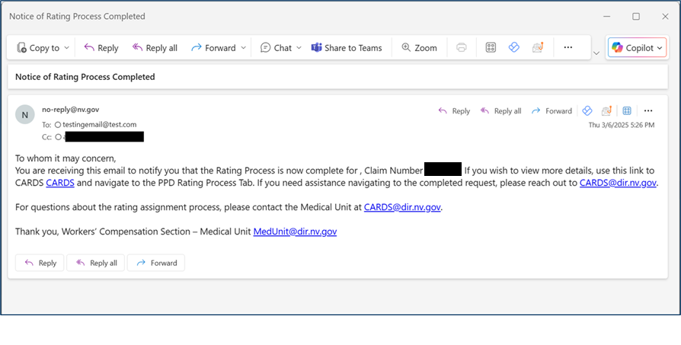
COMPLETING THE RATING PROCESS
RESPONDING TO A PPD RATING REQUEST
The rating process is complete once the rating has been submitted. An email will be sent to all involved parties including the requestor, the clinical practitioner, and any additional emails provided in the PPD transaction.

Slide 22
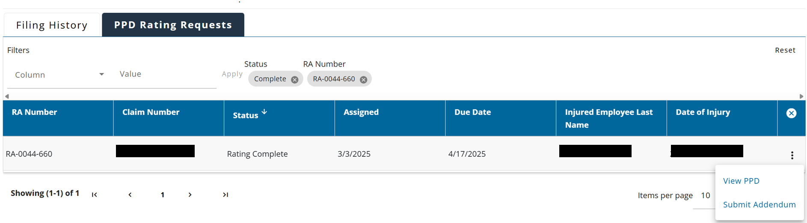
PPD RATING WEBFORM - ADDENDUM
UPLOADING THE RATING REPORT
After the rating has been submitted, if you choose to submit an Addendum on your request, open the Rating Webform using the “Submit Addendum” action on any completed request.

Slide 23
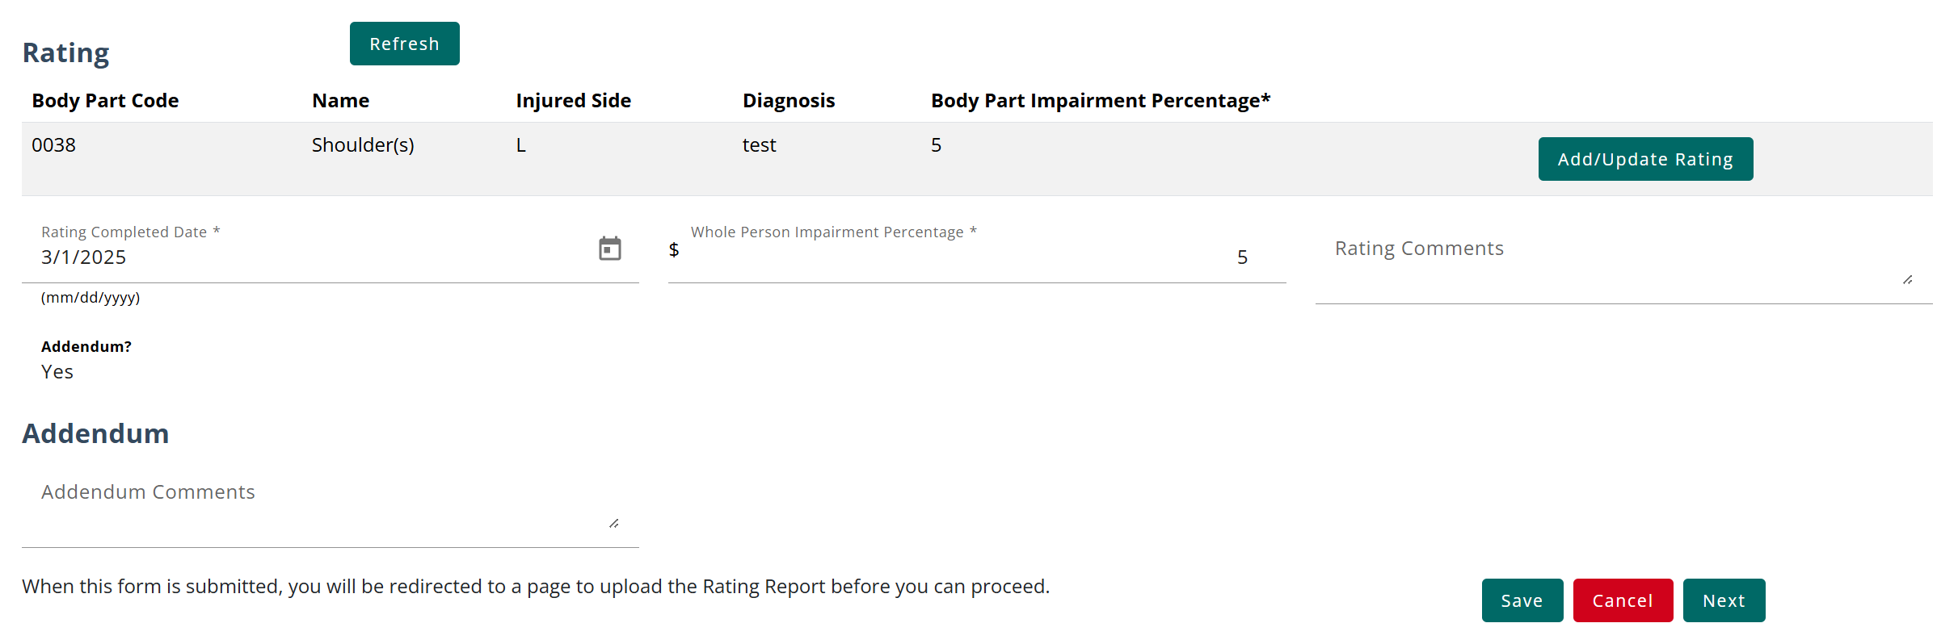
PPD RATING WEBFORM - ADDENDUM
UPLOADING THE RATING REPORT
Addendum to the Rating will allow the user to update the rating information, provide additional comments, and will require the physician to submit another rating report.

Slide 24
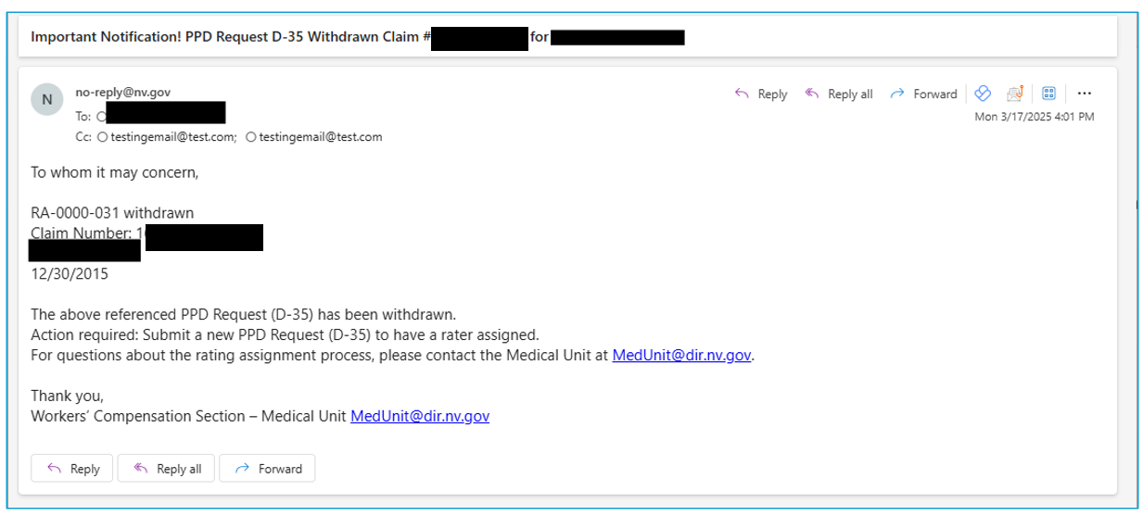
WITHDRAWN REQUEST
EMAIL NOTIFICATION
When a request is withdrawn, an email will be sent to all involved parties including the requestor, the clinical practitioner, and any additional emails provided in the PPD transaction. No additional action can be taken once a request is withdrawn.

Slide 25
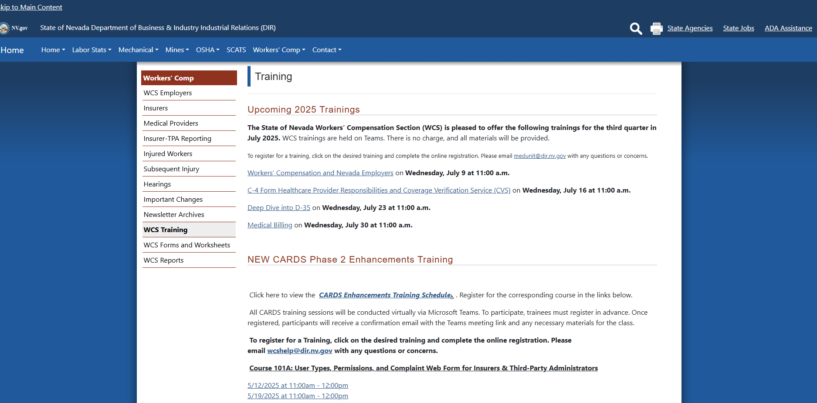
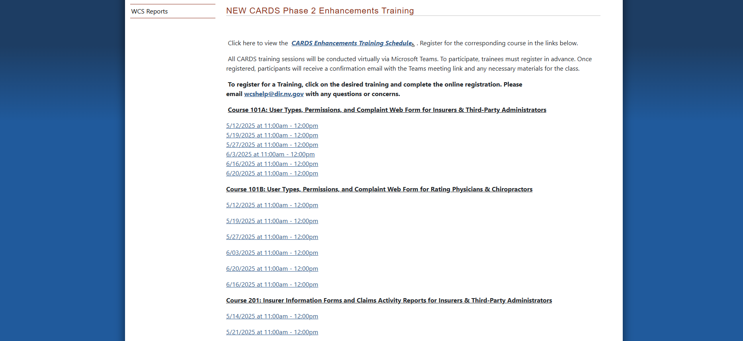
WHAT’S NEXT?

Slide 26

QUESTIONS?

Slide 27


THANK YOU

